Slide 1

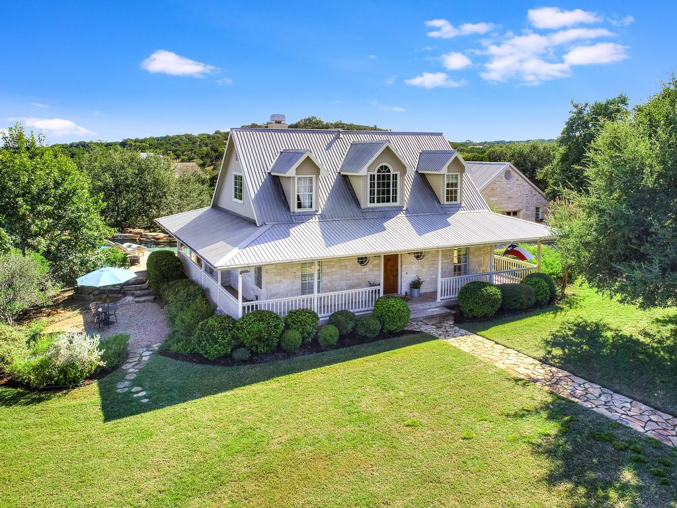
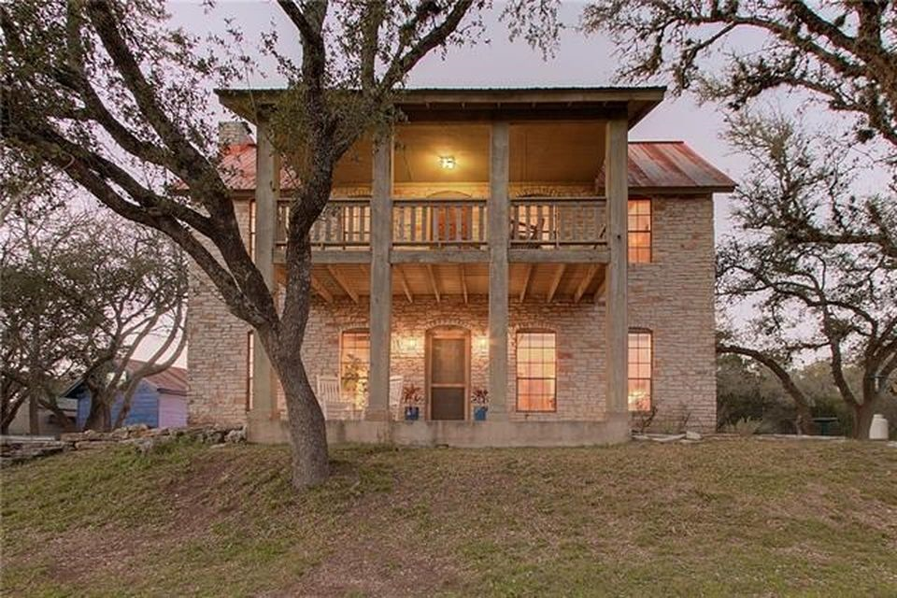
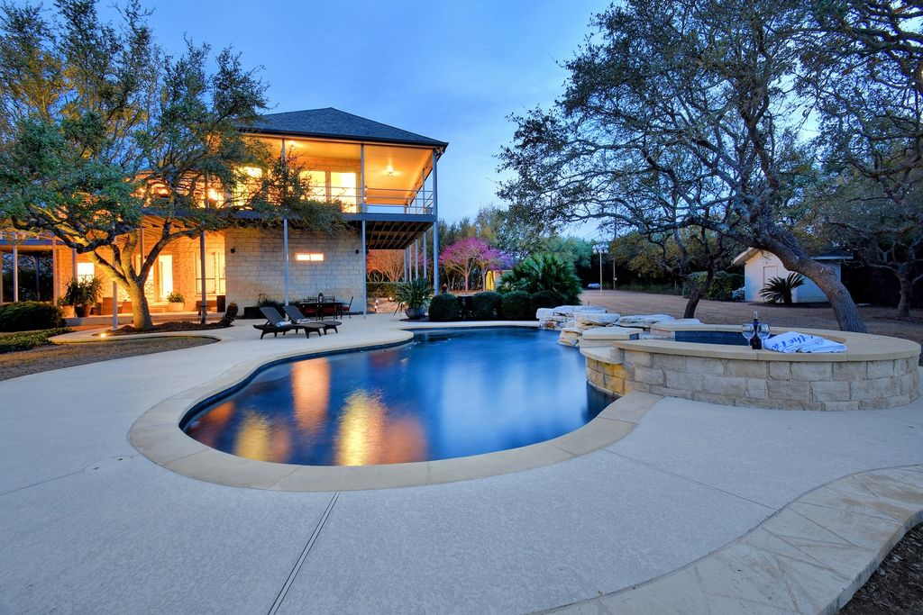
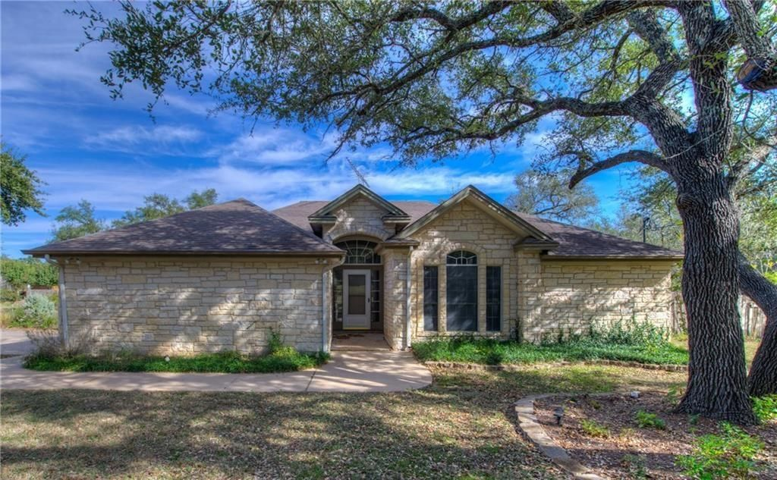
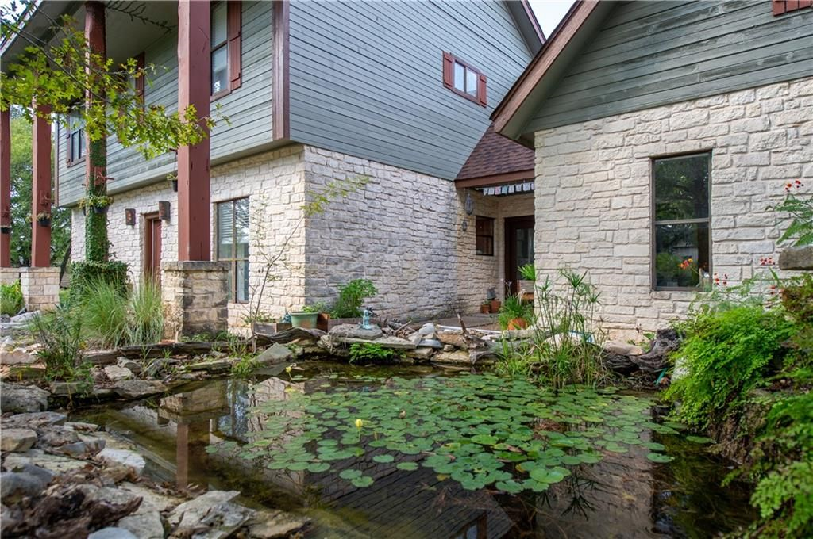
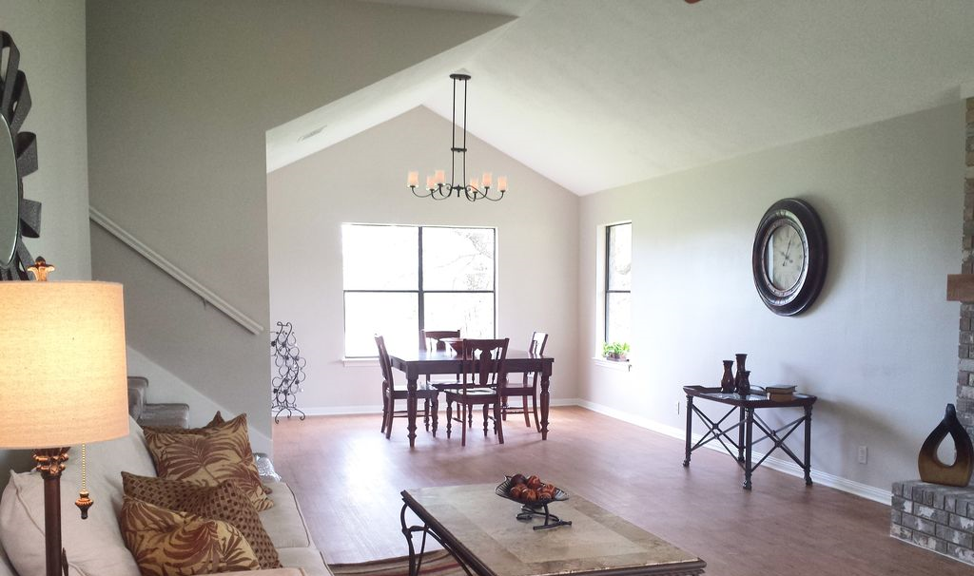
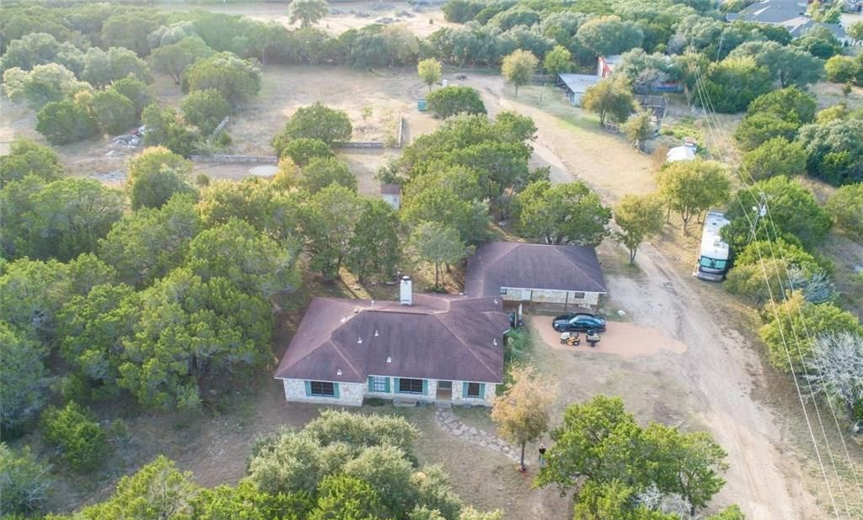
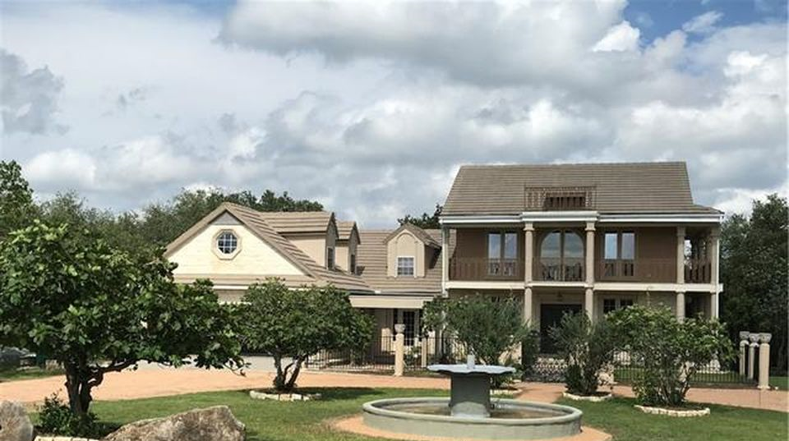
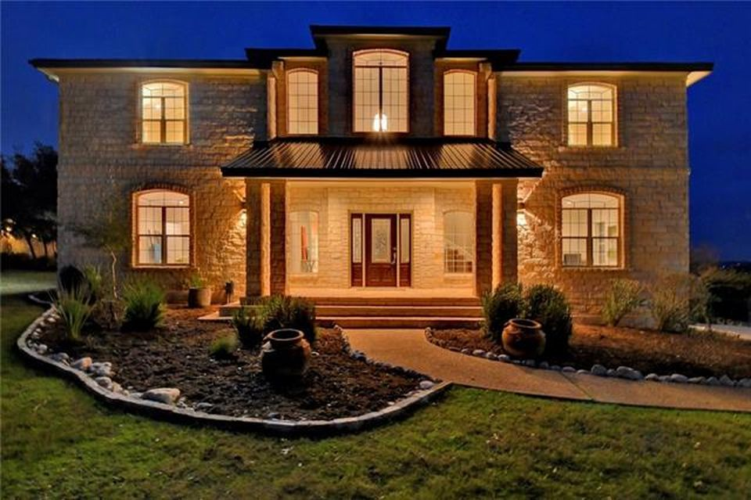
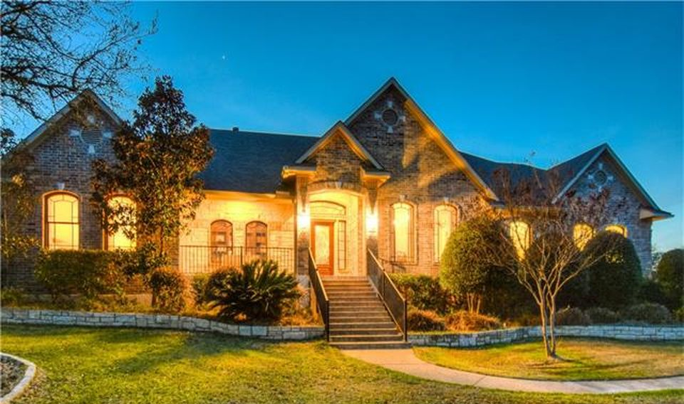
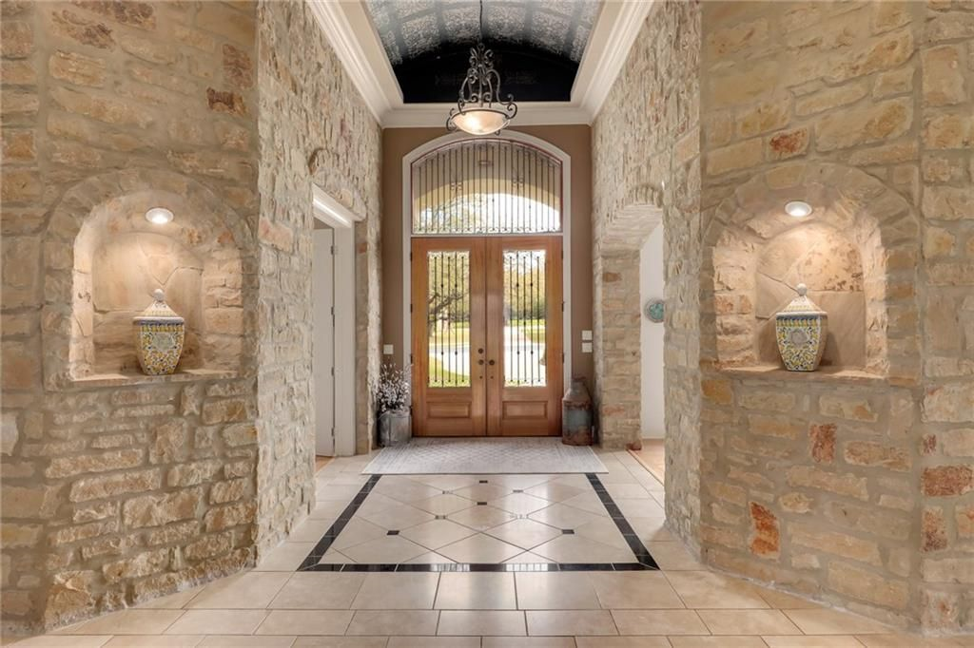
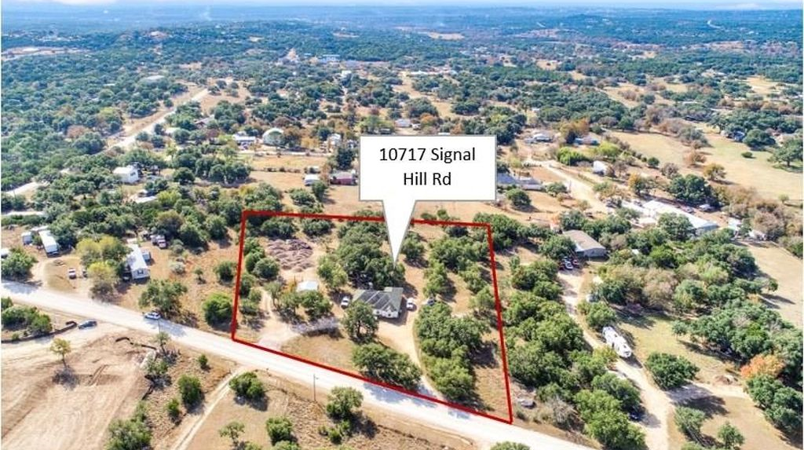
Austin, TX - House Listings
DATA ANALYSIS OF THE HOUSING MARKET
Prepared by: Nina Sysoeva

Slide 2
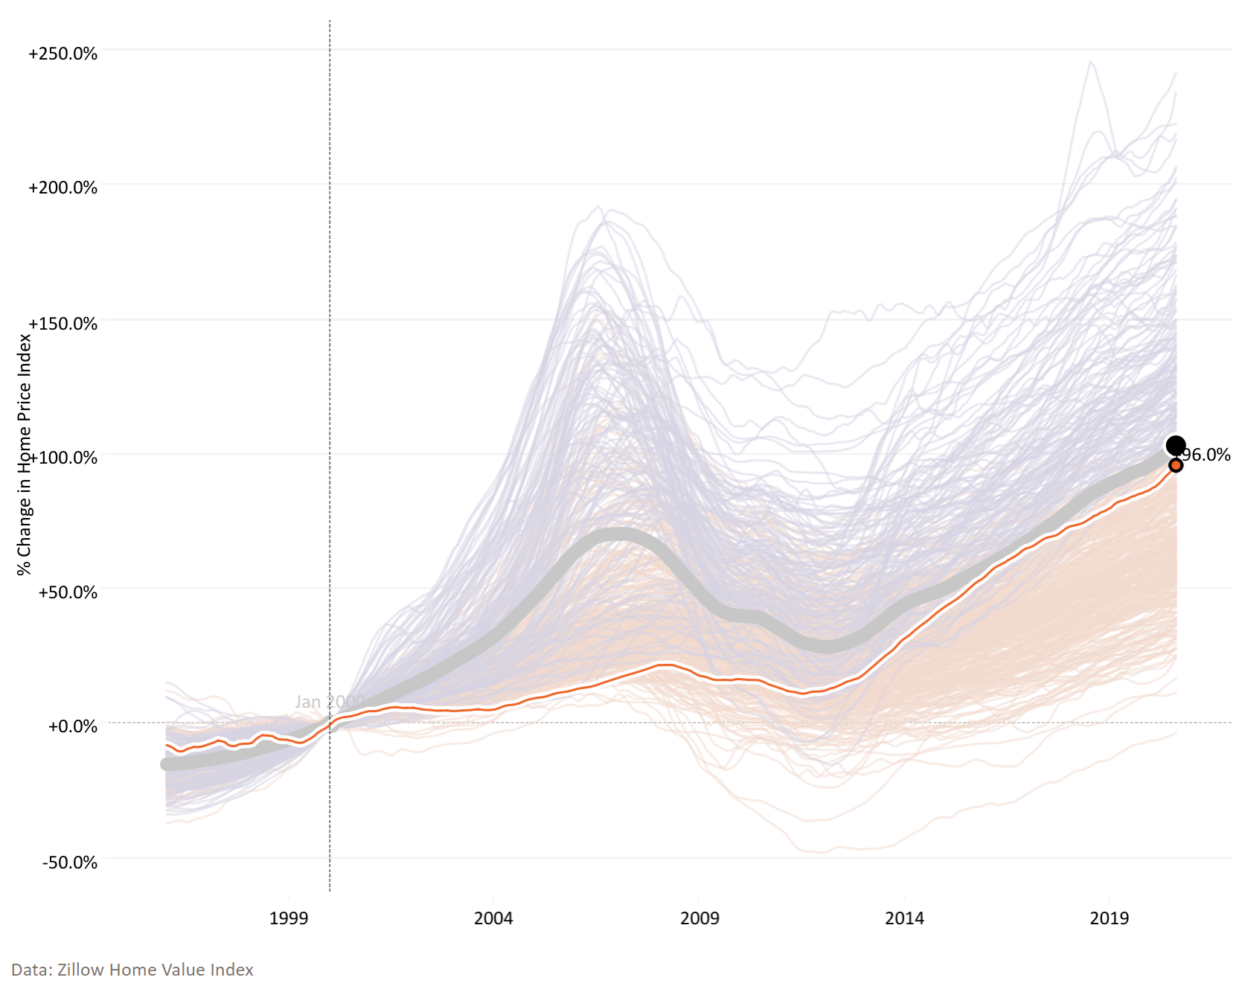
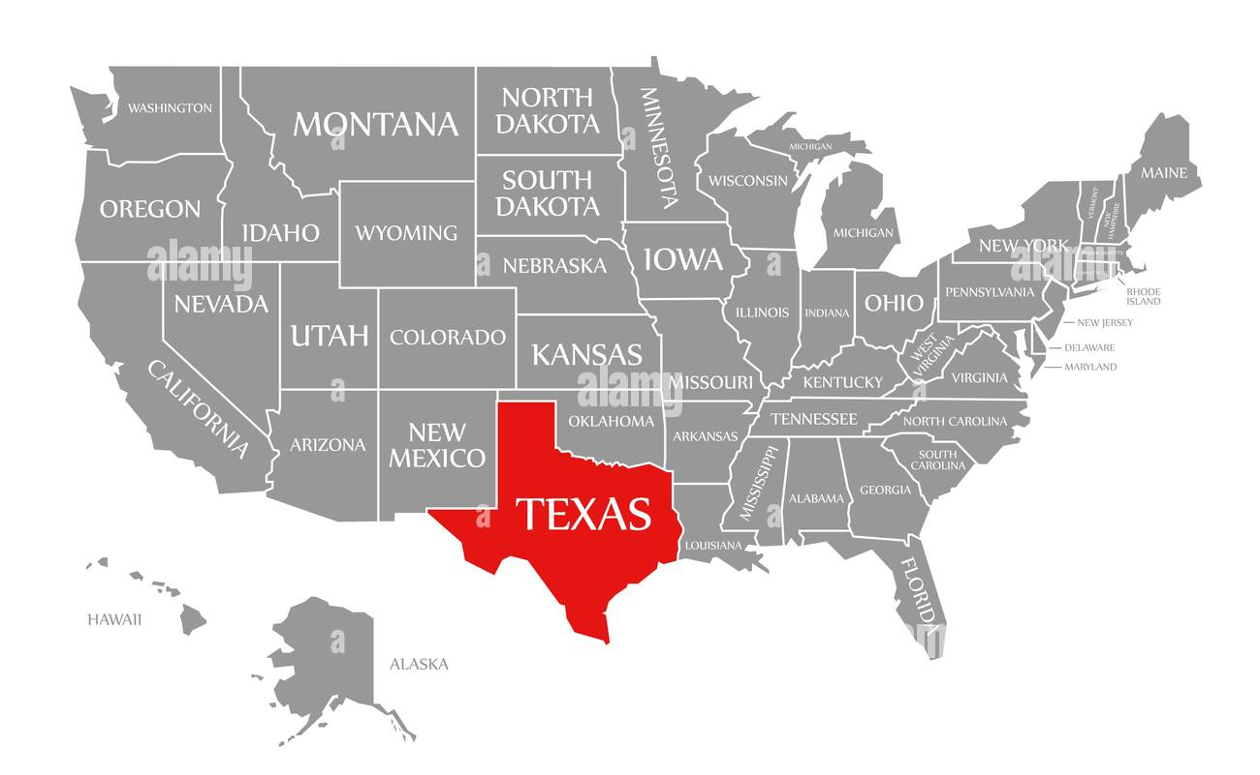
Austin 20-Year Home Price Index Growth Is Comparable to the U.S. Average
Home Price Index Change Across U.S. Metro Areas: Jan 2000 – Aug 2020
 | Austin, TX | U.S. Avg.
Difference Jan 2000 – Aug 2020 | +96% | +103%
Home Price Index (Aug 2020) | $357k | $257k
U.S. Avg.
Austin, TX
Our dataset was scraped in Jan 2021
https://www.visualcapitalist.com/20-years-of-home-price-changes-in-every-u-s-city/
Notes:
To set the stage, here is the U.S. home price index.
Home Price Index = average home value (single-family home)
We are looking at prices from 2000 up until 2020
First, the trajectory of home prices is defined by the 2008 Financial Crisis. After prices took a steep dive, it took a full decade for the average home price to rise back up to the 2007 peak.

Slide 3
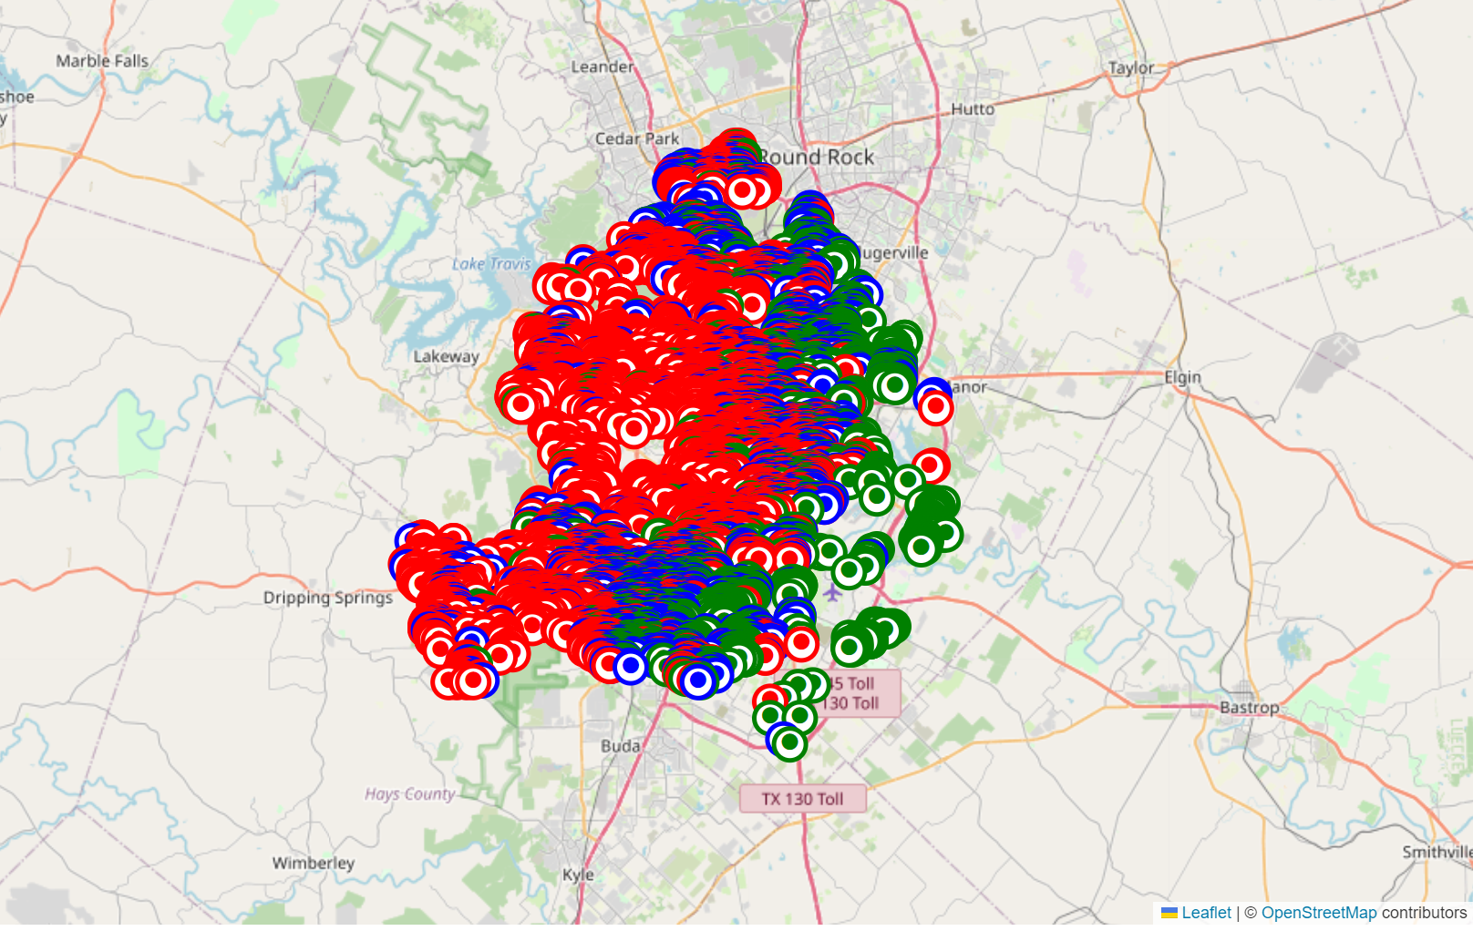
Housing Properties Clustered Around Austin Based on Their Price Bracket
12 MB
<$309k (1st Quartile)
<$405k (Median)
47 Features
>$405k
Austin
~15,000 Rows
Based on Zillow Listings
Targeting to Predict Housing Price column (“latestPrice”) – dependent variable
Notes:
- Data contains X
- As the next step, we investigated the data further. It contained no duplicates and only a few missing values in the description column. Because the missing values were very few (2), we have removed the rows that contained them.
- Further, we have looked at the geographic map of housing properties and identified that the properties generally cluster by price, with those <$309k (1st quartile of the distribution) located on the east side of the city, those between $309k and $405k (where $405k is the median value) spread in the middle of the city, from north to south, and those >$405k located in the central and western edge of the city.

Slide 4
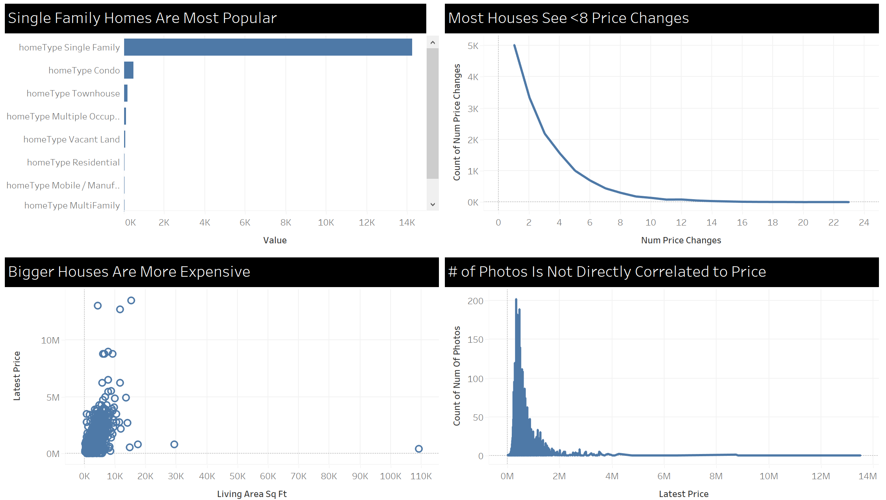
[x]
1-8 price changes is the “sweet spot”
Single Family homes by far most popular home type (dummy variable)
Unsurprisingly, price is not directly correlated to # of photos, although there is a relationship
However, the effect of outliers is evident

Slide 5
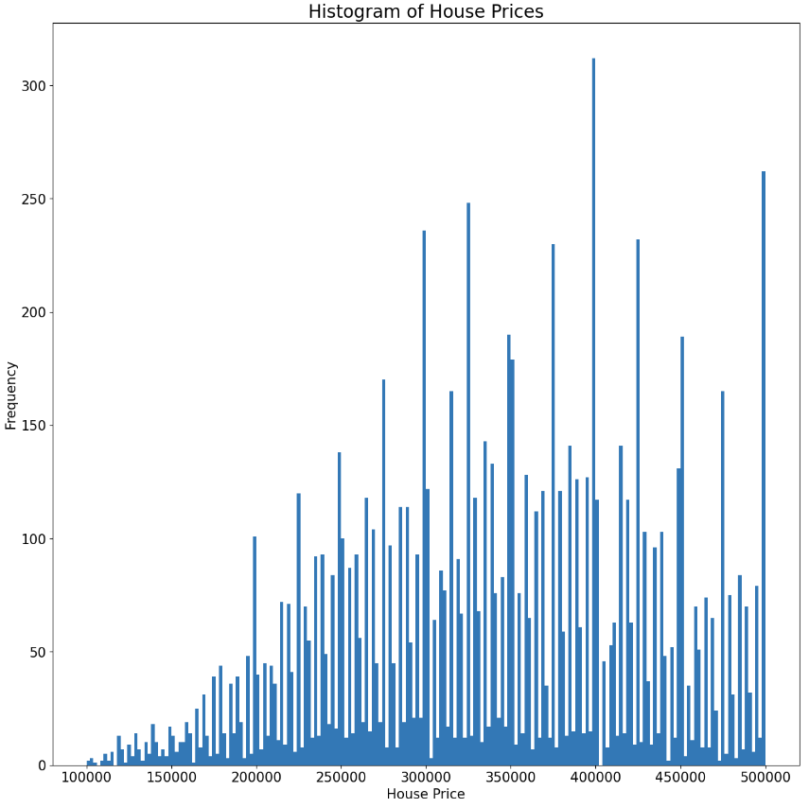
54 Independent Features Used; Optionality to Remove Outliers Based on Price
54 Independent Features Used in the Analysis
latitude | numOfParkingFeatures | numOfStories
longitude | numOfPatioAndPorchFeatures | city_del valle
propertyTaxRate | numOfSecurityFeatures | city_driftwood
garageSpaces | numOfWaterfrontFeatures | city_dripping springs
hasAssociation | numOfWindowFeatures | city_manchaca
hasCooling | numOfCommunityFeatures | city_manor
hasGarage | lotSizeSqFt | city_pflugerville
hasHeating | livingAreaSqFt | city_road
hasSpa | numOfPrimarySchools | city_west lake hills
hasView | numOfElementarySchools | homeType_Condo
parkingSpaces | numOfMiddleSchools | homeType_Mobile / Manufactured
yearBuilt | numOfHighSchools | homeType_MultiFamily
numPriceChanges | avgSchoolDistance | homeType_Multiple Occupancy
latest_salemonth | avgSchoolRating | homeType_Other
latest_saleyear | avgSchoolSize | homeType_Residential
numOfPhotos | MedianStudentsPerTeacher | homeType_Single Family
numOfAccessibilityFeatures | numOfBathrooms | homeType_Townhouse
numOfAppliances | numOfBedrooms | homeType_Vacant Land
We will look at models both including and excluding outliers
Removing outliers: keeping House Price in $100k-$500k range
latestPrice
Notes:
Later in our analysis, we have revealed that our dependent variable (Price) has outliers going up to $13.5M. We have then chosen to eliminate the outliers and run some of the regression models on data which excludes rows where housing prices are >$500k.

Slide 6

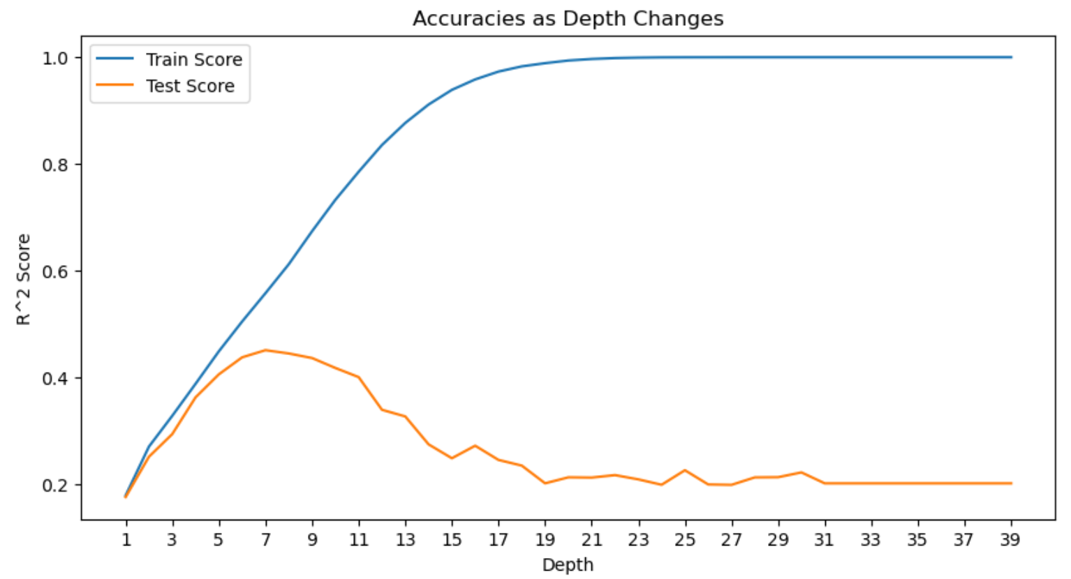
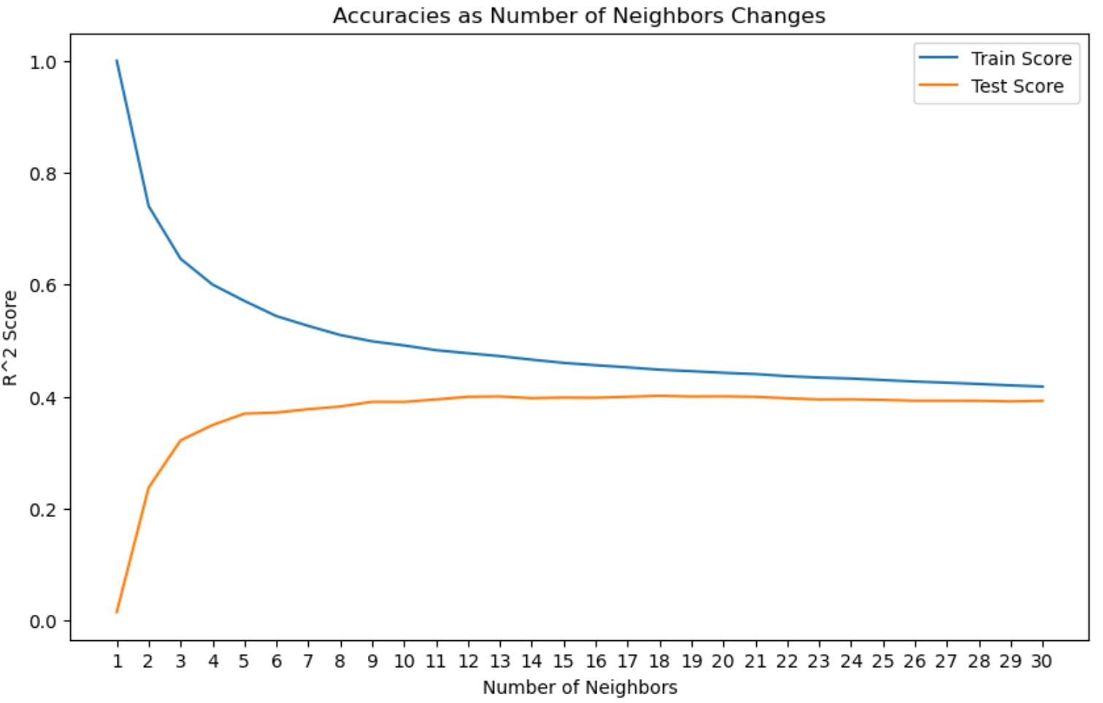
Decision Tree and KNN Regressor Are Superior Models for Our Data
Linear Regression
10 Independent Features
Incl. Outliers: -43%
Excl. Outliers: 15%
Decision Tree
54 Independent Features
After excluding outliers:
depth = 7
Incl. Outliers: 25%
Excl. Outliers: 45%
?
KNN Regressor
54 Independent Features
After excluding outliers:
n_neighbours = 10
Incl. Outliers: 49%
Excl. Outliers: 39%
?
Notes:
- Proportion of the variance in the lastPrice that is predictable from the independent features
- All percentages are for test data
- Tried to optimize for hyperparameter “weights” for KNN Regressor. Setting hyperparameter "weights" to "distance" (meaning that closer neighbors will have more influence on the prediction than farther ones) makes the model overfit. By default, weight is uniform (keeping it as such).

Slide 7

Let’s Dive Deeper Into KNN Regressor (Including Outliers)
KNN Regressor – What Do the Results Show?
Example:
y-test:
$650k
y-predicted:
$403k
Predicted house price is within 40% of actual house price ~50% of the time
KNN Regressor - Snapshot
54 Independent Features
After excluding outliers:
n_neighbours = 10
Incl. Outliers: 49%
Excl. Outliers: 39%
Notes:
Example:
y-test = $650k
y-predicted = $403k
The prediction is 38% below the actual, thus it falls in the second bucket.

Slide 8
Two Linear Regression Iterations Resulted in Accuracy of ~30%
INDEPENDENT FEATURES COUNT
PROCESS DESCRIPTION
46
1
Need to adjust this slide if would like to keep for linear regression
“description” column – processed using NLP
“city” and “homeType” columns → dummy variables
154
2
Sequentially dropped features with correlation >0.5
No multicollinearity identified
124
3
Dropped features that had p-values >0.05
Linear Regression
55
4
Initial
Linear Regression
55 features; large coefficients
Removed outliers
Linear Regression
Dropped features that had p-values >0.05
28
5
Train Score: ~31%
Test Score: ~33%
Notes:
For CountVectorizer, we have capped the maximum features at 100 and dropped tokens used <10 times from the vocabulary.
“city” and “homeType” columns → dummy variables
Also, dropped a few columns (such as Zillow identifier) that were not meaningful as first step
-----------------
Before removing outliers: Train = 33%
Test = 41%

Slide 9
Conclusions & Next Steps
Explain what R^2 means
Explain why certain models give certain results
Explain why results are bad
Do some graphic in tableau / dashboard
Need a prototype on how to implement the project
Need to read and incorporate feedback from sprint 2
Decision tree regressor (before removing outliers) gives the best accuracy result of 52%
However, I would generally expect higher accuracy (70-80%) given the good amount and relevancy of the independent features available to us
Next steps – explore other available regressor models attempting to identify one with a higher test score
Optimize hyperparameters of other available regressor models to tune up their performance
Notes:
Overall, I would expect a higher accuracy score from the model, perhaps closer to 70-80%. It appears that we have a plenty of relevant independent variables accessible to us. The only model anywhere remotely close to my projection is decision tree regressor on 124 independent variables (before removing outliers, so on all 15,171 rows of the data).
Neural networks
KNN – regressor

